Slide 1







98% Patients get donors with pure blood
MY PROJECT
DONORS PLEASE HELP BY DONATE BLOOD…
SAVE THE LIFE WITH YOUR BLOOD…
BDMS BLOOD BANK
CREATED BY
Guide By
Santosh Sahu - U19CN378(santoshsahu0228@gmail.com)
Lohith Seelam - U19CN392(Lohithseelam3@gmail.com)
Dr. P. Rama
Assistant Professor
Dept Of Computer Science Engineering
BHARATH INSTITUTE OF HIGHER EDUCATION AND RESEARCH

Slide 2
Agenda:
Domain.
Aim and Objective.
Purpose.
Literature Survey.
Problem Statement.
Existing System.
Proposed System.
Software and Hardware Requirements.
Function Requirements.
Architecture Diagrams.
Modules.
Implementation
Installation Steps.
Results screenshot .
Conclusion.
Reference

Slide 3
BDMS BLOOD BANK
Domain:
BDMS BLOOD BANK is a web application which taken from a domain “Blood
Management System”. This stores the different group of bloods in one place like a bank. And
BDMS full form is blood donation management system.
//How I Choose This Project?
The BDMS Blood Bank is my first and best project. I get the idea to make this project from our collage which conducted blood donation camp which attracts me to make the project.
//Why I Choose This Project?
Actually Our College Blood donation Camp take me to my past. Where my friend suffered due to not get his matching blood group donor , because his blood group is rare group .
//How you Choose The Title Of The Project?
These Project is actually a ‘Blood Donation Management System’. So I sorted it to BDMS. After I just casually named the title ‘BDMS Blood Bank’. It’s the Little History behind the Title choosen of mine…

Slide 4
Aim and Objectives
To facilitate the needy person.
Needy person can find same blood grouped type.
Donor need to register himself.
Uneducated people can register near medical shops, hospitals and other medical supplies for not only register and there enable voice assistant and image Identifier in their web-application.
After register no one can get problem by using this web.
No one can access the personal information of the donor.

Slide 5
Literature Survey:-
C.A, Sankar, K. and Kannan, S. (2014) in a research of “A Study of Blood Bank Management”, defined Blood Bank Information System is an information management system that inform to the management of donor records and blood bank.
In research entitled “Blood Bank Management System” done by 3Kumar, R., Singh, S. and Raghavi, V.A. (2017), developed a web-application based blood management assists the blood donor records management, and provides the control in distribution of blood products in various places of the country from the hospitals.
In research entitled “Blood Bank Management System” implent 3Kumar,R., Singh, S. saru , V.A. (2019),In this research, the researchers get the idea of importance of implementing a web-application based blood bank management system in records for blood donors and blood donation camps to provide available information for blood provide services.

Slide 6
4. In the research entitled “Blood Bank Management System Rule-Based Method” provide by
4Liyana, F. (2017), it found that it is important for every hospital to use an information system
to manage data in blood bank. Also, it observed that the manual system has disadvantages
for the user and the hospital. One of the disadvantages identified was the blood bank staff
should enter the donor details in each time he/she donate blood in which led to duplicate data
of the donor and also the data may be lost or missing after period of time.
5. G. Carello Department of Electronics, Milan, Italy in the research Blood Banks systems are
more focus on hospitals and others local blood banks Blood bags are produced to
procedures, to get a consistency of each .(Council of Europe 2007).Despite the importance of
this content, the literature on blood collection system thinking is rare (Ofori et al. 2005; WHO
2008; Lieshout - Krikke et al. 2013).

Slide 7
Problem Statement:-
People who need blood are increasing day by day. Who have diseases like Thalassemia or people who have gotten into accidents and run out of blood need constant supply of blood to sustain their life and there is not enough blood availble for them .
The local blood banks and others sources are not secure and safe as in literature author says. By focus on the problem BDMS Blood Bank created with new modern features with rapido emergency delivery. Also with screening phase tests.
BDMS are stores the donor records and the blood banks secure and safe by using cyber feature and also check safety while rapido delivery that not to sell any others.

Slide 8
Existing System:-
This management system codes is not our execution. Others executed code is runs in this application.
our system is updatating with extra codes which get our system such big features while I get more positive results.
Blood bank management system named website executed code is runs in our application. which is now updated to next level .

Slide 9
Requirements:-
Software Requirements :-
CLIENT SIDE:
By executing HTML , CSS , Bootstrap , JavaScript as FrontEnd.
Backend JAVA .
SERVER SIDE:
PHP.
MySQL for database.
Using WAMP Server.
With APACHE.
In the Storage of Amazon Cloud.
Hardware Requirements:-
Implementing on WINDOW- 11.
8GB RAM.
Of i3 core@ 1.20GHz processor.
By 64-bit operating system , x64 based Processor.

Slide 10
Proposed System
Our system take the application a next level. By updated a modern featured codes. Now our application had voice assistant, sign recognizer and image Identifier features .
Also included RAPIDO delivery request features, which take a big success and more help to donors and acceptors with a outstanding platform.
Our system use the executed code with updated codes in XAMPP server in APACHE and MySQL database, while stored it in Amazon cloud.

Slide 11
FUNCTIONAL REQUIREMENTS:-
Administrator should have access to all the system.
For the donor page, Name, Address, Contact/email and blood group should be mandatory.
The system enable the all the system information to the needy person to add their blood request.
The request process must be easy to send.
The admin needs to forward proper blood group request.
The admin give access to acceptors and donors to enable voice and image Identifier access for uneducated people.

Slide 12
MODULES:-
Blood banks are more important for the process of storing bloods and manages blood stocks, approving blood requests, updating donation camp and updating available blood grouped types.
BDMS web-based Blood Bank Management System will solves the issues and problems encountered in collecting information about donors, blood camps, inventories of blood bags, and blood transfusion services, etc , including donor screen phase, management, blood ordering, blood usage results and disease testing.
Blood Bank Management system increases the security and quality of the blood supply as well as provide donor and blood bank data for the supply chain management and delivery with help of Rapido

Slide 13
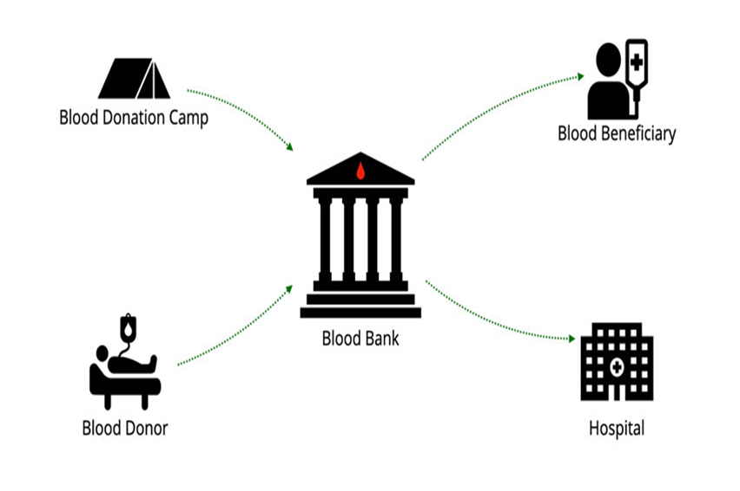




ARCHITECTURE DIAGRAM :
BDMS
Blood Bank
With Help Of Rapido

Slide 14
IMPLEMENTATION:-
Front end: HTML, CSS, JavaScript
HTML: HTML is used to create and save web document. E.g. Notepad/Notepad++
CSS : (Cascading Style Sheets) Create attractive Layout
Bootstrap : responsive design mobile freindly site
JavaScript: it is a programming language, commonly use with web browsers.
Back end: PHP, MySQL
PHP: Hypertext Preprocessor (PHP) is a technology that allows software developers to create dynamically generated web pages, in HTML, XML, or other document types, as per client request. PHP is open source software.
MySQL: MySql is a database, widely used for accessing querying, updating, and managing data in databases.
-----XAMPP is for both frontend and backend.....

Slide 15
INSTALLATION STEPS-
STEP-1: Download zip file and Unzip file on your local server.
STEP-2: Put this file inside “c:/wamp/www/” .
STEP-3: Database Configuration
Open phpmyadmin
Create Database named donor.
Import database donor.sql from downloaded folder(inside database)
STEP-4: Open Your browser put inside “http://localhost/BDmanagement/”
STEP-5:
Admin Login Details
Login Id: admin
Password: password

Slide 16
RESULT___ SCREENSHOT:

Slide 17
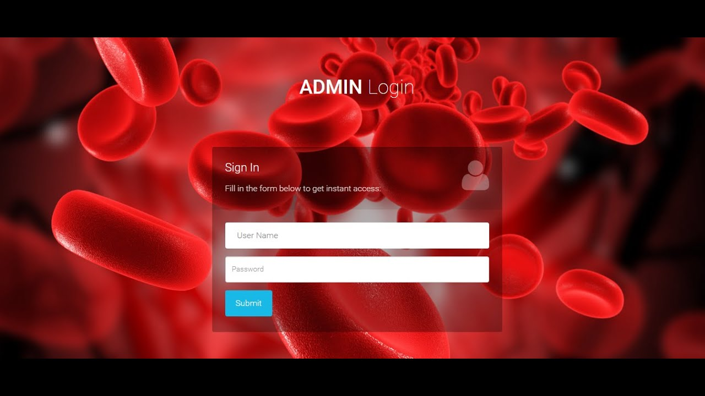
LOGIN PAGE-
THIS LOGIN PAGE AND REGISTER PAGE, THE UNEDUCATED HAVE TO TAKE HELP FROM
MEDICAL STORES OR ANY EDUCATED PEOPLE FOR LOGIN AND REGISTER PAGE.......

Slide 18
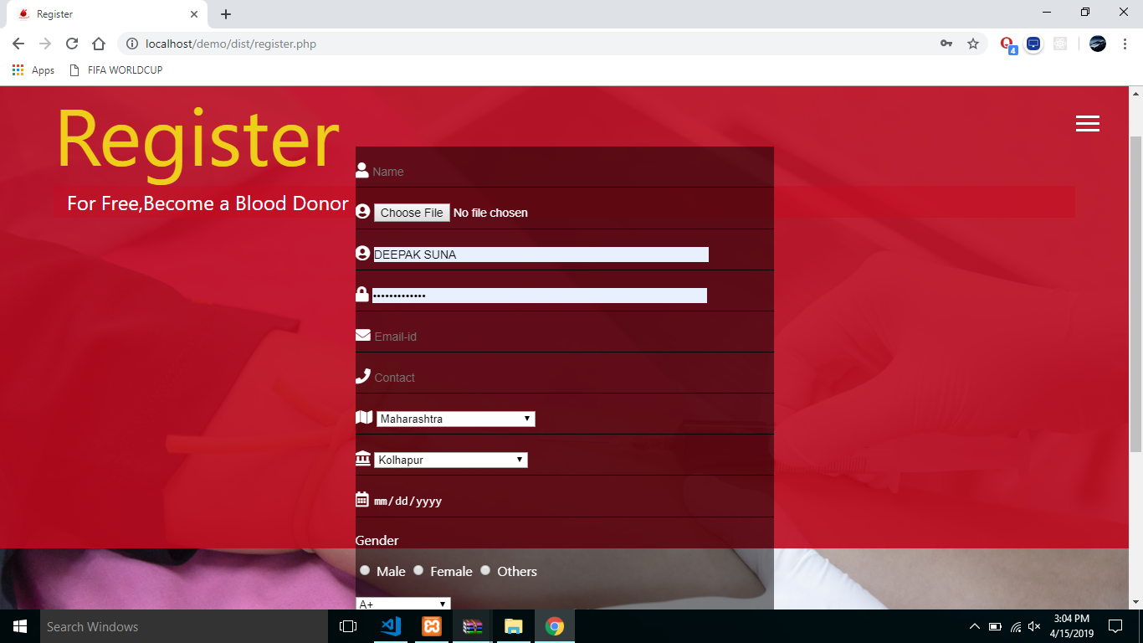
REGISTER PAGE

Slide 19
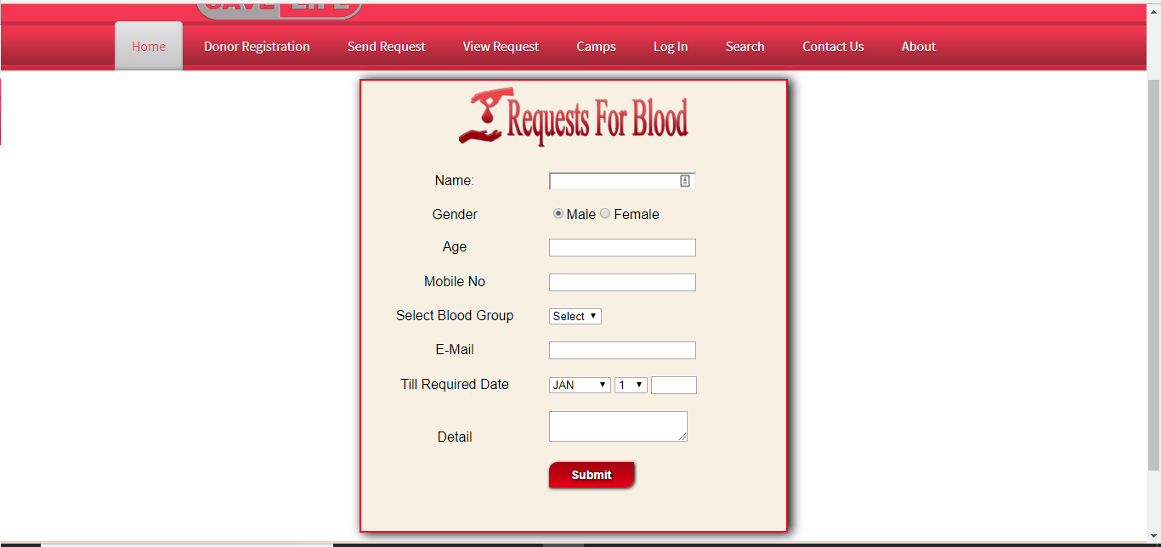
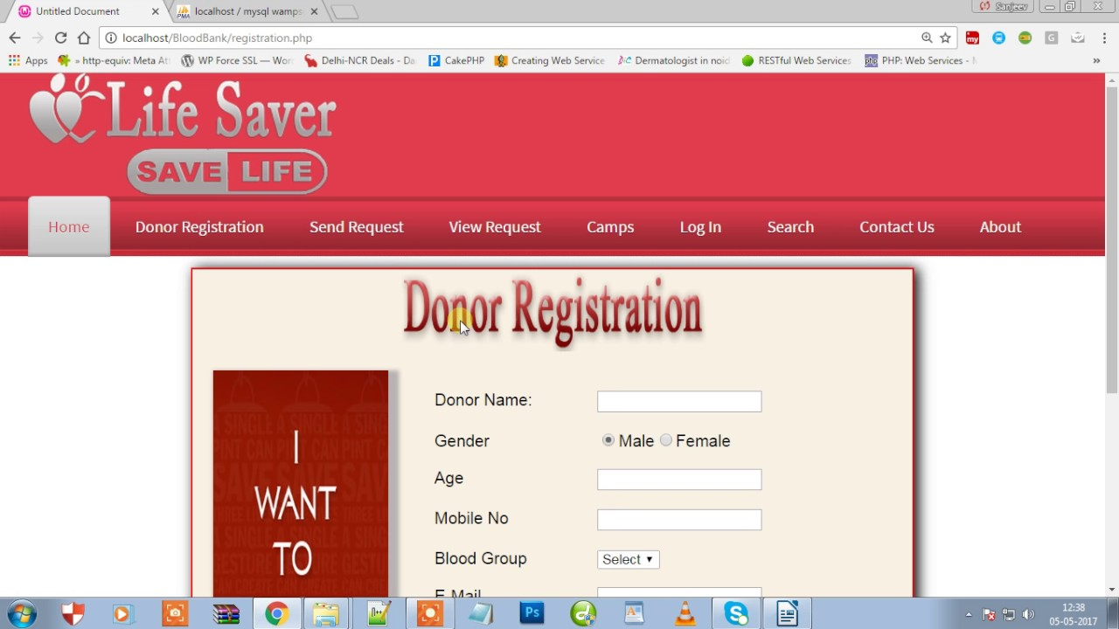

DONOR AND ACCEPTOR BLOOD REQUESTS

Slide 20
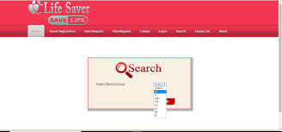
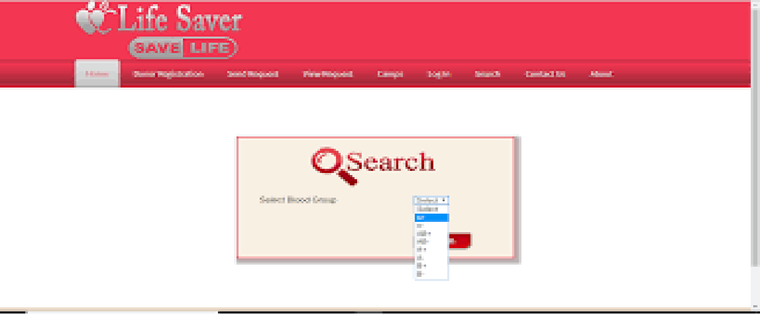

VOICE ASSISSTANT

Slide 21


SIGN IDENTIFIER

Slide 22
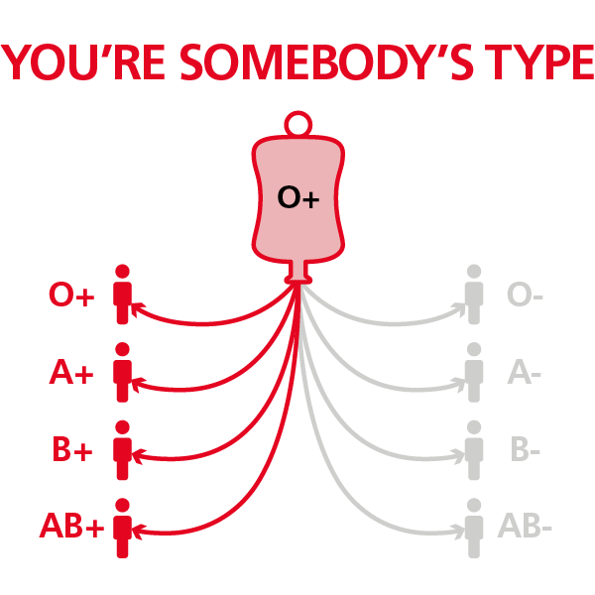
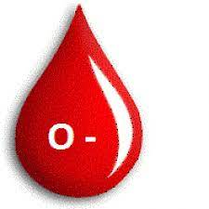
IMAGE INDENTIFIER

Slide 23
RAPIDO EMERGENCY

Slide 24
Conclusion:-
Based on the Abstract and from literature surveys , it was found out that , our web- based BDMS Blood Bank Project provide convenience, efficiency and security to the system users and hospitals compared to the manual systems .
It was found out that manual systems have many disadvantages that disappoint and dissatisfy users. Indeed, Our online BDMS blood bank application Project make work easy, and ensures fast retrieval of data when needed with a time to time updates.

Slide 25
REFERENCE
[1]Safe blood and blood products. Module 1: Safe blood donation. Geneva: World Health Organization; 2002. [17 August 2012]. http://www​.who.int/bloodsafety​/transfusion_services​/bts_learningmaterials​/en/index.html.
[2]Blood donor selection. Guidelines on assessing donor suitability for blood donation. Annex 3. Geneva: World Health Organization; 2012. [17 August 2012]. http://www​.who.int/bloodsafety​/voluntary_donation​/blood_donor​_selection_counselling/en/ [PubMed]
[3]Aide-mémoire. Blood safety. Geneva: World Health Organization; 2002. [17 August 2012]. http://www​.who.int/bloodsafety​/publications​/who_bct_02_03/en/index.html.
[4]WHO/IFRC. Towards 100% voluntary blood donation: A global framework for action. Geneva: World Health Organization; 2010. [17 August 2012]. http://www​.who.int/bloodsafety​/publications​/9789241599696/en/ [PubMed]
[5]The Melbourne Declaration on 100% voluntary non-remunerated donation of blood and blood components. Geneva: World Health Organization; 2009. [17 August 2012]. http://www​.who.int/worldblooddonorday​/Melbourne​_Declaration_VNRBD_2009.pdf.

Slide 26


Slide 27

THANK YOU

